Slide 1
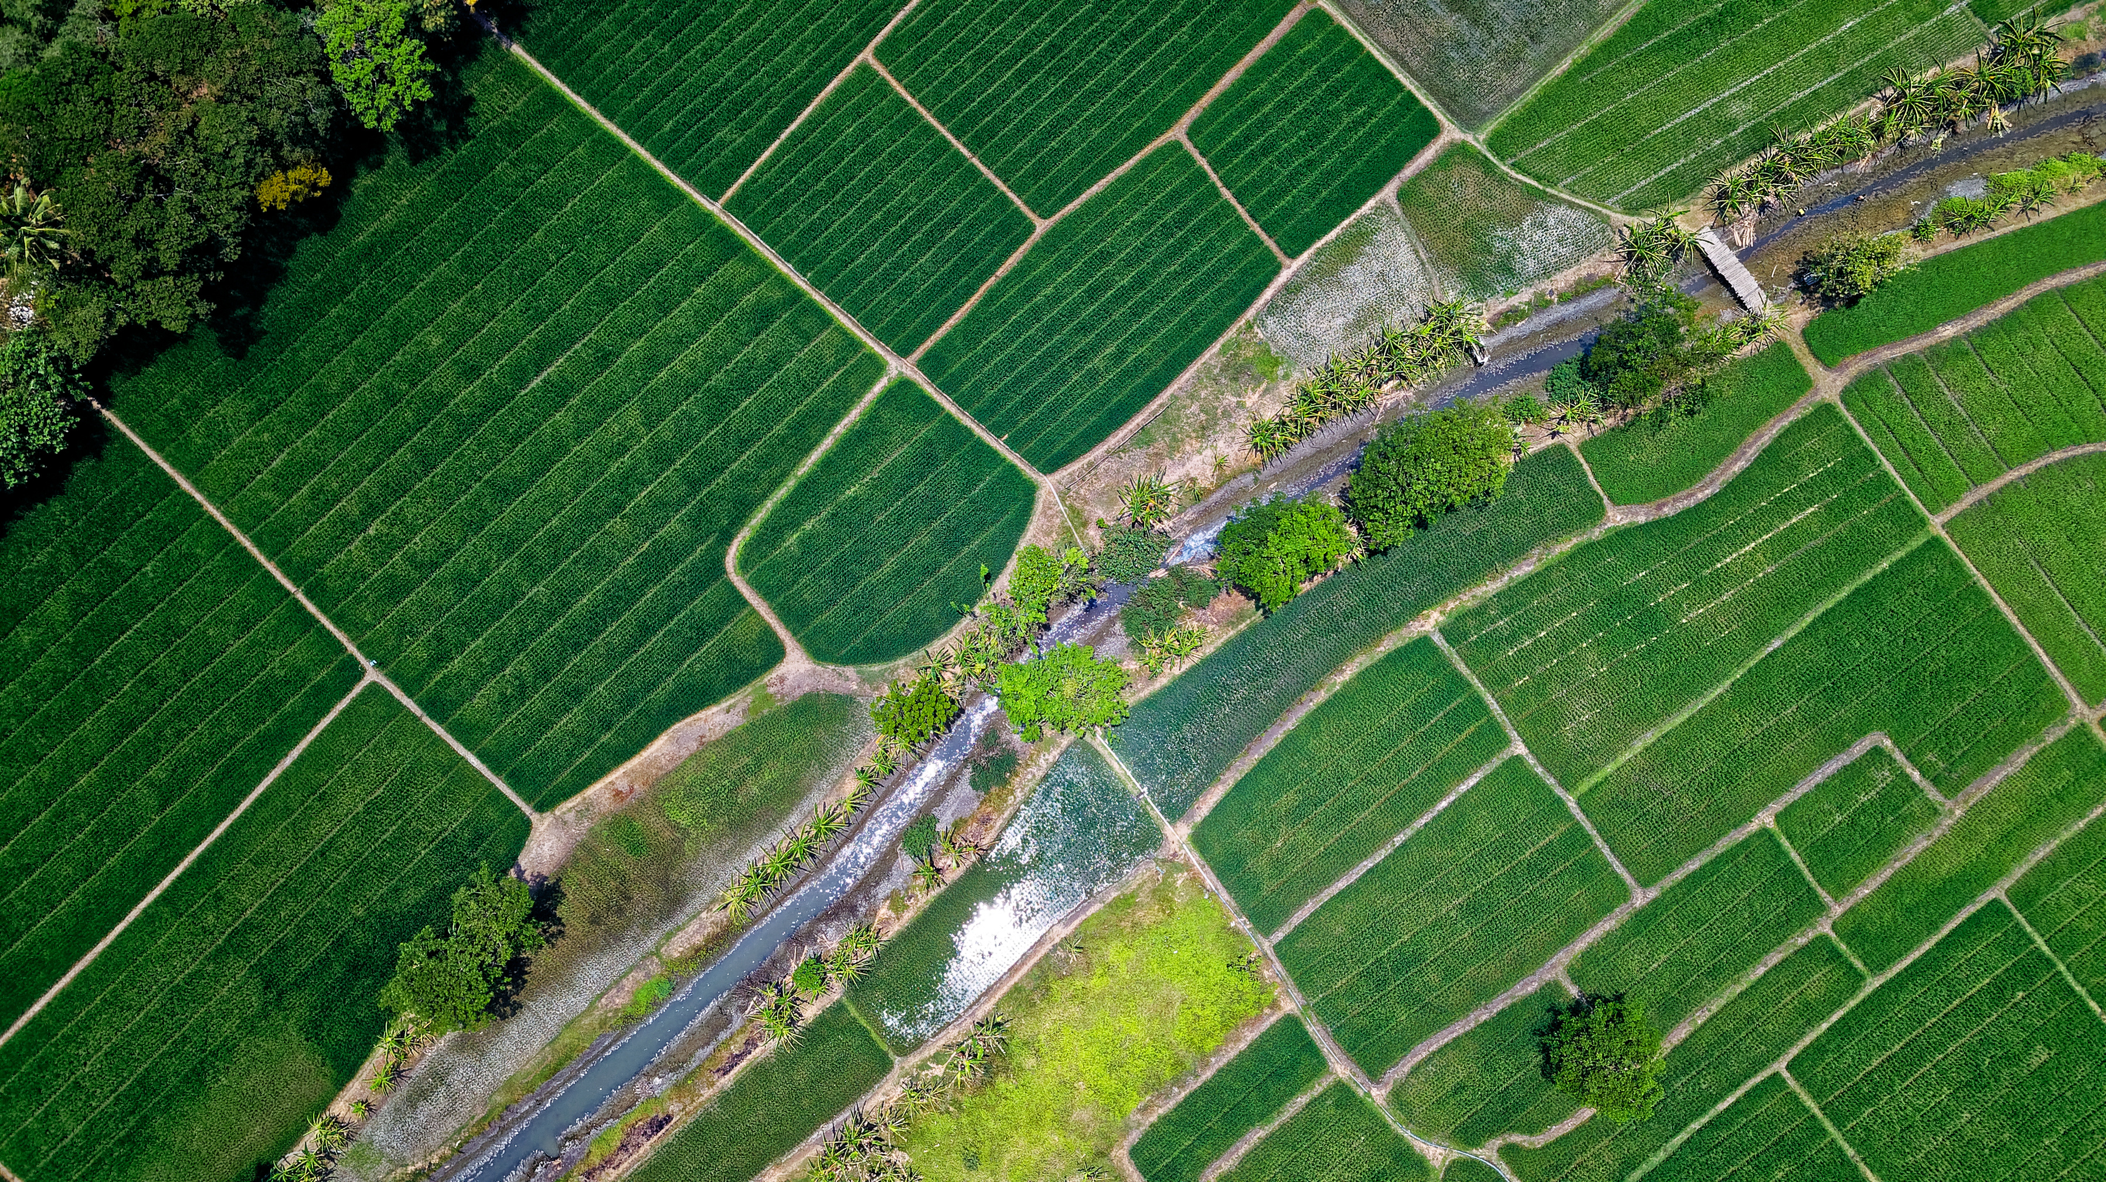



Code Zen
A Comparative Study of Machine Learning Models for Rice Price Prediction
in Sri Lanka
Start Slide
>
Group 02
| Code Zen
| Mr. Dhanushka Jayasinghe
Page 01

Slide 2
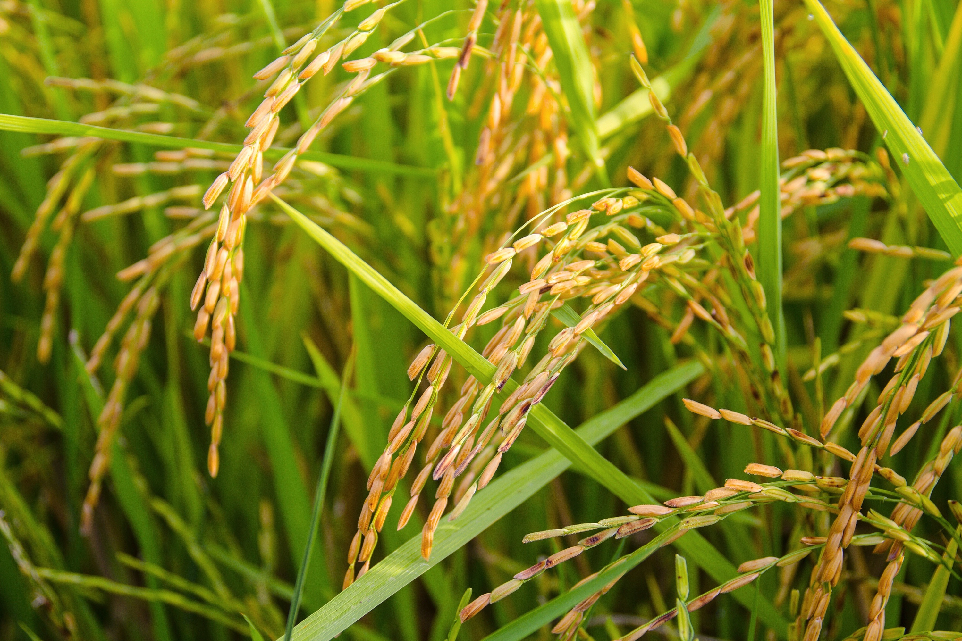

CODE ZEN
Problem Statement
Rice price fluctuations in Sri Lanka are influenced by multiple factors, including climate conditions, crop yield variations, and foreign exchange rate fluctuations. Farmers and market stakeholders often struggle to predict these price changes, leading to financial instability, inefficient resource allocation, and difficulties in planning harvests and sales. Traditional forecasting methods are insufficient in addressing the complex interplay of these variables, necessitating a data-driven approach to improve price predictions and decision-making.
Sub Problems
Lack of Standardized Pricing Mechanisms in Local Markets
Limited Availability and Reliability of Historical Data
Seasonal and Festival-Based Demand Fluctuations
Unpredictable Shocks (Natural Disasters and Pandemics)
1376
Page 02

Slide 3

Purpose and Significance
of the Research Study
CODE ZEN
Research Purpose
Develop a data-driven model to predict rice retail prices in Sri Lanka.
Integrate key factors: weather patterns (rainfall, temperature, radiation), rice yield data, and LKR-USD exchange rates.
Address price fluctuations due to climate, production, and economic factors.
Provide a reliable forecasting tool for farmers and traders.
Significance of the Study
Helps farmers plan harvests efficiently and avoid losses.
Supports traders and policymakers in managing supply chains.
Reduces market uncertainty and enhances price stability.
Considers exchange rate impact on local rice prices.
Contributes to food security, economic stability, and agricultural sustainability.
.
1376
Page 03

Slide 4

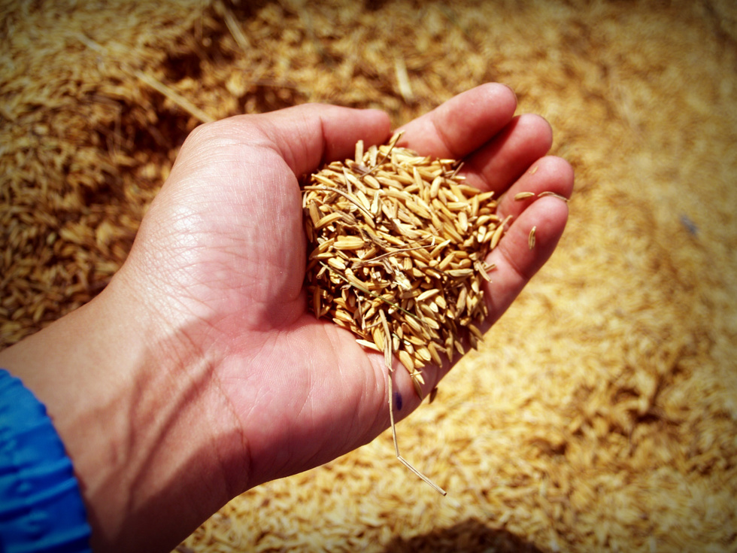
CODE ZEN
RESEARCH
QUESTION(S)
How do key weather factors, such as rainfall, temperature, and radiation, influence retail rice prices in Sri Lanka?
What is the relationship between rice yield and retail price fluctuations in Sri Lanka?
How do exchange rate fluctuations impact retail rice prices in Sri Lanka over time?
What are the most effective machine learning approaches to enhance the accuracy of retail rice price prediction models?
1376
Page 04

Slide 5
CODE ZEN
AIM
To develop a machine learning-based predictive model for forecasting retail price of the rice in Sri Lanka, by integrating rainfall, temperature, radiation, rice yield trends, and LKR-USD exchange rate fluctuations.
Page 05
1306

Slide 6

OBJECTIVES
CODE ZEN
To Analyze the impact of weather on retails price of the rice by examining how rainfall, temperature, and radiation affect production and market pricing in Sri Lanka, identifying seasonal patterns and extreme weather effects.
To Evaluate the relationship between rice yield and price fluctuations by assessing historical production data and market trends to understand supply-demand dynamics.
To Assess the influence of exchange rate variations on retails price of the rice by studying LKR USD fluctuations and their impact on import costs, exports, and agricultural inputs.
To Optimize the prediction model’s accuracy by fine-tuning hyperparameters, validating with historical data, and evaluating forecasting techniques for reliable decision-making.
Page 06
1306

Slide 7


CODE ZEN
RESEARCH METHODOLOGY
Page 07
Quantitative, AI & ML-based approach to predict rice prices in Sri Lanka using weather, yield, exchange rates, and paddy prices.
Data Collection: Collecting historical datasets on weather conditions, rice yield, LKRUSD exchange rates, and paddy buying prices.
Data Preprocessing: Cleaning, transforming, and normalizing the data to ensure consistency and accuracy.
Feature Engineering: Identifying the most influential features (independent variables) that affect rice prices.
Model Development: Comparing and implementing various AI and ML algorithms to forecast rice prices.
Model Evaluation & Optimization: Evaluating model performance and optimizing parameters to ensure high prediction accuracy.
1381

Slide 8
CODE ZEN
Research Design
Data Collection: Historical data from meteorological, agricultural, and financial sources.
Data Preprocessing: Handling missing data, outlier removal, normalization, and time-series transformation.
Feature Engineering: Identifying key variables influencing rice prices.
Page 08
Techniques & Tools
ML Models:
Random Forest, XGBoost – for feature importance & boosting.
ARIMA – for time-series forecasting.
LSTM – for long-term dependencies in sequential data.
Evaluation: RMSE, MAE, R² Score, cross-validation.
Optimization: Hyperparameter
tuning via GridSearchCV/RandomizedSearchCV.
Tools: Python (NumPy, Pandas, Scikit-learn, TensorFlow,
Statsmodels), visualization libraries (Matplotlib, Seaborn).
Implementation Workflow
Data Preprocessing – Cleaning, handling missing data, and normalization.
Model Selection & Training – Testing ML models on historical data.
Evaluation & Optimization – Performance assessment and hyperparameter tuning.
1381

Slide 9
EXPECTED RESEARCH RESULTS AND/OR INNOVATIONS
CODE ZEN
Weather-Impact Analysis
Examines how rainfall, temperature, and solar radiation affect rice production and prices.
Helps farmers and traders anticipate seasonal price changes.
Yield-Price Dynamics Insight
Identifies correlations between rice yield variations and price fluctuations.
Supports better production and storage planning.
Exchange Rate Influence
Analyzes LKR-USD impact on rice prices via import costs and input prices.
Helps policymakers and farmers understand external economic factors.
Innovative Decision Support Tool
Develops a web-based platform for real-time price forecasting.
Assists stakeholders in making informed harvesting, storing, and selling decisions.
Enhanced Forecasting Techniques
Uses machine learning to optimize prediction models.
Improves accuracy through historical data validation and model fine-tuning.
1381
Page 09

Slide 10
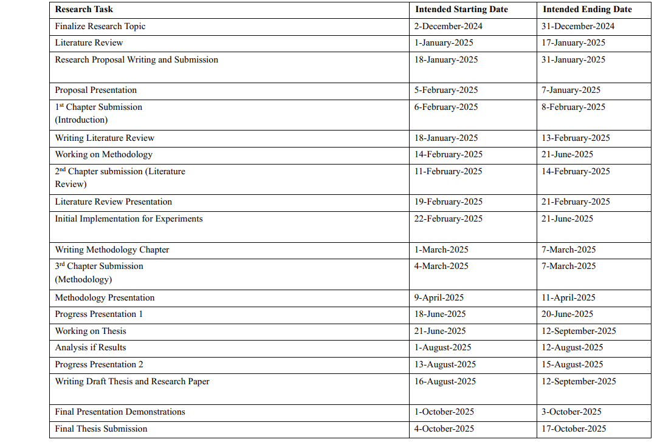
RESEARCH SCHEDULE / WORK PLAN
CODE ZEN
1381
Page 10

Slide 11
PRELIMINARY REVIEW OF LITERATURES
CODE ZEN
The study "Rice Price Forecasting Using the ARIMA Model" examines the factors influencing rice price fluctuations in Eastern Pangasinan, Philippines, using timeseries data from the Philippine Statistics Authority and the ARIMA model for forecasting. The literature reviewed highlights key determinants such as agricultural inputs (fertilizers, fuel, and machinery), climate conditions, supply chain disruptions, market competition, and government policies. Studies indicate that rice prices are projected to rise steadily from 2024 to 2028, with regular well-milled rice increasing by 5.68% annually and special rice by 1.80% to 1.71% over four years. The findings suggest that rising production costs and supply instability contribute to price surges, outpacing the estimated 2% annual increase in consumer salaries, which may strain household economies. Further research comparing ARIMA with alternative forecasting models is recommended to enhance prediction accuracy and inform policy interventions.[1]
Another study explores the impact of the COVID-19 lockdown on rice prices in India using machine learning-based time series forecasting models. The researchers applied ARIMA, ANN, and ELM models to predict price fluctuations caused by supply chain disruptions. Their findings indicate that the ARIMA intervention model estimated a price increase of INR 0.92/kg during the lockdown, while the ELM model outperformed other approaches due to its ability to capture nonlinear patterns in price movements. The study highlights the effectiveness of machine learning models, particularly ELM, in agricultural price forecasting under crisis scenarios. This research underscores the need for adaptive forecasting models that can assist policymakers in mitigating the effects of unforeseen market disruptions.[2]
1336
Page 11

Slide 12
PRELIMINARY REVIEW OF LITERATURES
CODE ZEN
Another investigation analyzed the use of Artificial Neural Networks (ANNs) for forecasting paddy yield in Sri Lanka. This study focused on climate factors such as temperature, rainfall, and humidity to predict seasonal rice production. The research compared three gradient descent optimization techniques—Batch Gradient Descent (BGD), Stochastic Gradient Descent (SGD), and Mini-batch Gradient Descent (MBGD)—in training ANN models. The findings revealed that BGD outperformed the other methods in terms of accuracy, proving its efficiency for paddy yield forecasting. The study emphasized the limitations of traditional time-series models, such as ARIMA, in handling nonlinear relationships in agricultural data.[6]
Similarly, another study explored the integration of feature-engineered machine learning models to enhance rice yield prediction. This research compared Linear Regression (LR), Support Vector Machine (SVM), k-Nearest Neighbors (KNN), and Random Forest (RF) models using climate data, including rainfall, temperature, and solar radiation. The results demonstrated that Random Forest Regression, with a reduced number of features, achieved similar predictive accuracy to models using a complete feature set, indicating the effectiveness of feature selection in optimizing model performance. This study contributed to food sustainability efforts by improving predictive accuracy, aligning with the United Nations Sustainable Development Goals (SDGs).[7]
1336
Page 12

Slide 13
PRELIMINARY REVIEW OF LITERATURES
CODE ZEN
In contrast to yield prediction, other research has focused on optimizing crop profitability using ML techniques. A proposed decision-support system for farmers aimed to select the most profitable crops based on historical market trends, production costs, and climatic conditions. By utilizing deep learning approaches such as Long Short-Term Memory (LSTM) networks and Time Series Analysis, the study identified patterns in market demand and supply fluctuations. A key finding was that integrating economic factors into crop selection could help stabilize market prices and maximize farmers' revenue. This study highlighted the role of ML in strategic agricultural planning and market-driven decision-making.[8]
Other research highlights critical findings related to the impact of economic indicators on rice production in Sri Lanka, focusing on machine learning applications. Key economic factors such as GDP, inflation rate, population growth, and imports have shown significant correlations with rice production outcomes. Models like Support Vector Machines (SVM), Linear Regression, and Gaussian Process Regression (GPR) have demonstrated improved prediction accuracy when compared to traditional methods. Further studies stress the importance of including environmental factors, such as climate change, in forecasting models. However, a gap exists in the research regarding the integration of fuzzy logic or hybrid models like Adaptive Neuro Fuzzy Inference Systems (ANFIS), which may more effectively handle complex, non-linear relationships between economic and agricultural variables. This gap is relevant to research on rice price prediction in Anuradhapura, where machine learning models are also being applied to forecast rice prices using weather data, yield trends, and exchange rate fluctuations. By considering these additional factors, such research could contribute to refining predictive models and providing more accurate forecasts, benefiting stakeholders like farmers, traders, and policymakers.[9]
1336
Page 13

Slide 14
PRELIMINARY REVIEW OF LITERATURES
CODE ZEN
Agricultural decision support systems play a crucial role in improving forecasting accuracy and aiding stakeholders in making informed decisions. One such system introduced an approach to predicting rice prices, rice production, and minimum rice requirements using a centralized data warehouse. The system utilized time series analysis, particularly the ARIMA model, to analyze historical trends and predict future market behavior. Similar studies have highlighted the influence of economic factors such as GDP, population growth, and inflation on rice price fluctuations, emphasizing the need for machine learning techniques to improve prediction models. While traditional statistical methods like ARIMA provide valuable insights, machine learning models such as Support Vector Machines (SVM), Random Forest, and neural networks have demonstrated superior predictive accuracy in handling complex, non-linear relationships in agricultural data. Moreover, integrating climatic variables like rainfall, temperature, and solar radiation into predictive models has been found to enhance forecasting reliability. Despite these advancements, a significant research gap exists in the adoption of hybrid approaches, such as Adaptive Neuro-Fuzzy Inference Systems (ANFIS), which could further refine predictive accuracy by capturing intricate interactions between economic, environmental, and production variables. Addressing this gap, recent studies have focused on applying machine learning models for rice price prediction in the Anuradhapura District, incorporating economic, climatic, and yield data to develop a robust forecasting framework. By leveraging advanced predictive techniques, this research aims to support farmers, traders, and policymakers in making data-driven decisions to stabilize rice markets and ensure food security.[10]
1336
Page 14

Slide 15
PRELIMINARY REVIEW OF LITERATURES
CODE ZEN
Several studies have explored rice price forecasting using econometric and statistical models, highlighting the influence of economic and environmental factors on price volatility. Some research has demonstrated that international rice prices, crude oil prices, and exchange rate fluctuations significantly impact domestic rice prices in Sri Lanka, using regression models and time series analysis. Other studies have emphasized the role of climatic factors such as rainfall and temperature variations in affecting rice yields and subsequent market prices. However, traditional forecasting methods, such as ARIMA and basic regression models, have limitations in capturing complex, nonlinear relationships in price prediction. Recent advancements in machine learning, particularly in models like Random Forest, XGBoost, and Long Short-Term Memory (LSTM) networks, offer improved accuracy by handling high-dimensional and time series data more effectively. Despite their success in global agricultural markets, these advanced AI-driven techniques remain underexplored in the Sri Lankan context, particularly in localized settings such as Anuradhapura. Addressing this research gap, new studies integrate weather patterns, rice yield trends, and exchange rate fluctuations into machine learning models to develop a more precise and dynamic rice price forecasting system, providing valuable insights for farmers, traders, and policymakers.[11]
1363
Page 15

Slide 16
Page 16
PRELIMINARY REVIEW OF LITERATURES
CODE ZEN
This paper highlights the growing application of machine learning (ML) models in predicting crop prices, a crucial aspect of agricultural sustainability. Various studies emphasize the effectiveness of regression-based models, such as Decision Tree Regression, Linear Regression, and Random Forest Regression, in forecasting price fluctuations. Research demonstrates the high accuracy of decision trees and XGBoost in price prediction, while Ridge and Lasso regression have been used to address multicollinearity issues in datasets. Additionally, time series models like ARIMA and LSTM have been explored for capturing trends and seasonality in price data. Advanced neural networks, including General Regression Neural Networks (GRNN), have also shown promise in crop yield prediction. However, challenges such as data availability, seasonal variations, and external market influences remain significant barriers to accuracy. The literature suggests that integrating multimodal data sources, including satellite imagery and weather trends, could further enhance predictive performance. Overall, ML-based price forecasting models contribute to informed decision-making for farmers, policymakers, and traders, supporting agricultural market stability and economic growth.[15]
The study on "Machine Learning Modelling of the Relationship between Weather and Paddy Yield in Sri Lanka" focuses on the application of machine learning techniques to predict paddy yield based on climatic factors. Prior research has established that weather conditions, including temperature, humidity, and rainfall, significantly influence agricultural productivity. Various statistical and machine learning models have been employed in different regions to analyze these relationships, with Random Forest (RF) emerging as a particularly effective tool due to its robustness in handling nonlinear interactions. Several studies have applied regression models, including Multiple Linear Regression (MLR) and Power Regression (PR), to estimate crop yields, often incorporating climate variables such as temperature, humidity, and precipitation. The literature highlights that while traditional regression techniques provide useful insights, machine learning models, especially RF, offer superior predictive accuracy. The study builds on this foundation by developing a machine learning-based crop-weather model for Sri Lanka, emphasizing the importance of weather indices in predicting paddy yield and comparing different modeling approaches for optimal performance.[13]
1363

Slide 17
PRELIMINARY REVIEW OF LITERATURES
CODE ZEN
Research on statistical models for identifying climate contributions to crop yields highlights three primary approaches: time-series models, cross-section models, and panel models. These models have been extensively used to analyze the relationship between climate variables and crop yields at different spatial scales, from site-specific to global levels. The review discusses the strengths and limitations of statistical models compared to process-based crop models, emphasizing their effectiveness in capturing climate impacts despite challenges like collinearity among climate variables and non-climatic trend removal. Additionally, the study underscores the need for improved data accuracy, better integration of adaptation strategies, and the combination of statistical and crop models to enhance predictive capabilities in agricultural climate studies.[14]
The research addresses the significant gap in applying machine learning models for rice price prediction. Despite extensive studies on rice production forecasting, most existing research has primarily focused on univariate time-series forecasting using ARIMA and Artificial Neural Networks (ANN). While ARIMA has proven effective for short-term predictions, there is a lack of comparative analyses involving advanced machine learning models such as Random Forest, XGBoost, and LSTM. Furthermore, much of the existing research emphasizes rice production trends rather than direct price forecasting, limiting its practical application in real-time economic decision-making. Another critical shortcoming is the absence of integrated models that incorporate multiple influencing factors, including weather conditions, rice yield variations, and exchange rate fluctuations. To address this gap, recent studies introduce a multi-factor, machine learning-based approach to predict rice prices, leveraging diverse data sources to enhance forecasting accuracy. This research aims to provide a comprehensive and data-driven predictive framework, supporting farmers, traders, and policymakers in making informed market decisions.[12]
1363
Page 17

Slide 18
PRELIMINARY REVIEW OF LITERATURES
CODE ZEN
A comprehensive review of machine learning applications in agricultural price prediction focuses on algorithm selection, research paradigms, and performance metrics. The study reveals that neural networks, especially ANN and SVM, are the most widely used models for predicting agricultural product prices due to their superior accuracy in capturing complex price patterns. The research also emphasizes that most studies adopt a positivist paradigm with quantitative and longitudinal approaches. Additionally, evaluation metrics such as RMSE and MAPE are commonly used to assess model performance. This study provides valuable insights into the evolution of machine learning techniques in agricultural economics and supports the use of AI based models for enhancing price prediction accuracy.[3]
Other studies employed the ARIMA model to analyze historical price data in Eastern Pangasinan, Philippines, identifying key determinants such as fuel, fertilizer, machinery, and climate conditions. The findings projected a steady rise in rice prices from 2024 to 2028, surpassing the estimated annual salary increase, indicating economic strain on consumers. Similarly, research comparing Linear Regression and Random Forest algorithms to predict premium rice prices in West Java, Indonesia, revealed that Random Forest outperformed Linear Regression, achieving higher accuracy (98.69%), and emphasized factors such as production levels, government policies, and market competition in price variations. These studies underscore the importance of data-driven forecasting for policymakers and stakeholders to mitigate market volatility and enhance food security.[4]
1363
Page 18

Slide 19
PRELIMINARY REVIEW OF LITERATURES
CODE ZEN
Recent studies on rice price forecasting have employed various statistical and machine learning techniques to improve prediction accuracy and support market stability. Research using the ARIMA model to analyze historical price trends in the Philippines highlights economic and environmental factors influencing rice prices, such as agricultural inputs, climate, and government policies. Comparisons between Linear Regression and Random Forest models for premium rice price prediction in West Java, Indonesia, found that Random Forest achieved superior accuracy (98.69%) in forecasting. Meanwhile, a Multivariate Fuzzy Time Series (MFTS) approach using Fuzzy Vector Autoregressive (FVAR) models has been introduced to predict rice prices and production in Malaysia, demonstrating that Trapezoidal Fuzzy Numbers (TrFNs) improved predictive accuracy over conventional VAR models. These studies underscore the importance of advanced forecasting models in mitigating rice market volatility, enhancing food security, and guiding policymaking. [5]
1363
Page 19

Slide 20
GROUP MEMBERS
CODE ZEN
Name | Registration No | Index No
B.M.N. Gayathri | ITT/2020/030 | 1306
C.M.V.S. Upananda | ITT/2020/112 | 1376
Y.M.G.D.L.Yapabandara | ITT/2020/119 | 1381
A. Sanjayan | ITT/2020/097 | 1363
A.R.D. Nawarathna | ITT/2020/065 | 1336
Page 20

Slide 21

CODE ZEN
YOU
THANK
For Your Attention!
Proposal Presentation
Group No 02
Mr. Dhanushka Jayasinghe
Page 21

